Slide 1
WEB3, Session 3
MVVM in Vue.js

Slide 2
Model/view separation
Single source of truth for any value in the UI (model/state)
Helps with:
Consistency
Single responsibility
What’s between the model and the view?
Controller (MVC)
Presenter (MVP)
Model-View-ViewModel (MVVM)
Binding

Slide 3
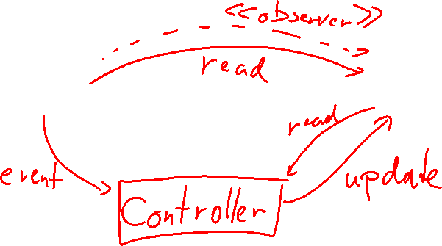
Model-View-Controller
View
model

Slide 4
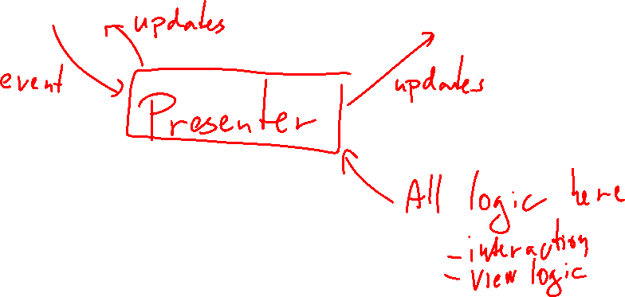
Model-View-Presenter
View
model

Slide 5
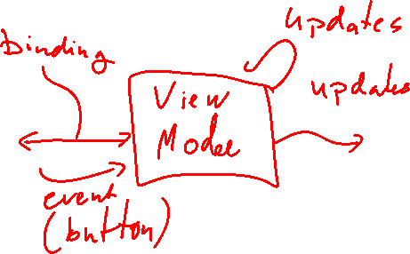
Model-View-ViewModel
View
model

Slide 6
Binding
Single vs double-bind
Single: Something in the view that reflects the VM
Double: Something in the view that both reflects the VM and updates the VM
How?
Use an observer
JavaFX properties
Vue.js
DIY
Update after each call to a method that might change VM
Angular

Slide 7
Vue js
View model
Options API
Create a view model as a JavaScript object
It needs certain predefined properties
This is the classic way - recommended for beginners
Composition API
Use some Vue functions that implicitly define the view model
Recommended for new projects and experienced developers
Template language
HTML with some extra attributes and other features
Both are defined in *.vue files (as of version 3)

Slide 8
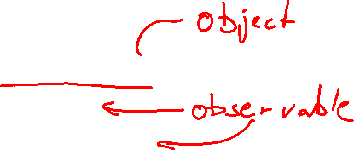
View Model (Options API)
In vue.js a view model consists of
data (properties)
computed properties
methods
…
These are called options
The view model is returned from the <script> section of the .vue file

Slide 9
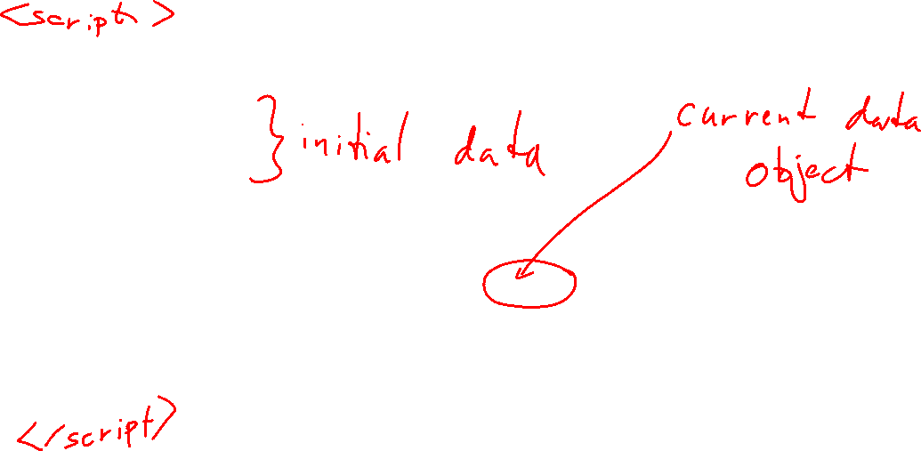
A view model (from options/reverse/App.vue)
export default defineComponent({
data() {
return {
s: "reverse"
}
},
computed: {
reversed: {
get(): string { return reverse(this.s)},
set(v: string): void { this.s = reverse(v) }
}
}
})

Slide 10
The data() method
The data method returns the initial value of the state
Vue.js wraps creates observers on the state
Triggers re-renders every time the state change
This is called a reactive state
In the view model the state is referred to by this - like this.s on the previous slide.

Slide 11

Computed properties
Properties derived from the state
May trigger re-render
computed: {
reversed: {
get(): string { return reverse(this.s)},
set(v: string): void { this.s = reverse(v) }
}
}

Slide 12
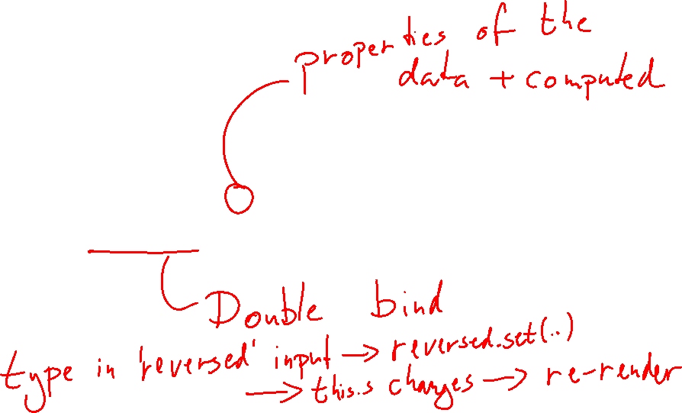
Template
<template>
<div id='base'>
<input v-model='s' id='normal'>
<input v-model='reversed' id='reversed'>
</div>
</template>

Slide 13
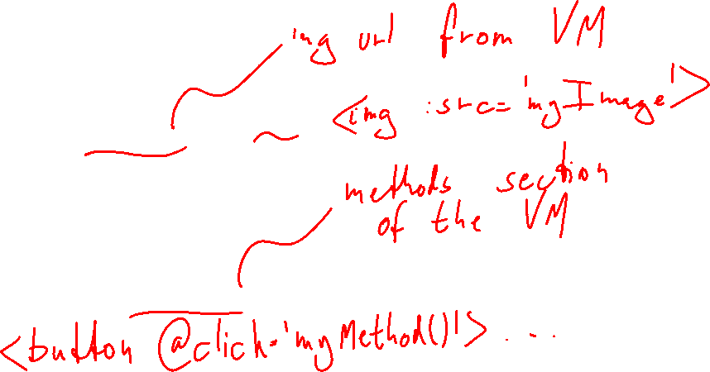
Binding in the template language
1-way
{{ property }}
1-way w/ properties
<img v-bind:src='myImage'/>
2-way
<input v-model='salary'/>
events
<button v-on:click='myMethod()'>ButtonText</button>

Slide 14
Method example (options/example/App.vue)
export default defineComponent({
data: () => ({
model: createModel(…)
salary: 0,
error: undefined
}),
…
methods: {
hire(id: number) {
const person = this.model.personById(id)
this.model.hire(person, this.salary)
this.salary = 0
this.error = undefined
}
}
})

Slide 15
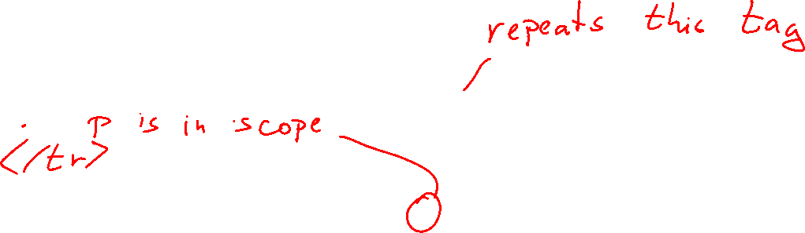
Template - see options/example/App.vue
Snippets:
<tr v-for='p in personData'>
<button v-on:click='hire(p.id)'>Hire</button>
<div v-if="error !== undefined">{{error}}</div>

Slide 16
Control Structures
v-for
Add as an attribute to indicate that the tag repeats for each element in an array. For instance, use it with <tr>, <li>, and of course <div>
v-if/v-else
Display element if true, don’t if false.
<template>
Use this to group elements that you can't group with anything else

Slide 17
Composition API
Composition vs options API is a question about how you will define the view model
Only the <script> part changes
Denoting composition vs options API:
Options: <script> / <script lang="ts">
Composition: <script setup> / <script setup lang="ts">
Choosing compositions vs options
Options has a strict structure - an object of a certain shape
Compositions has looser requirements
The main difference is how you create reactive objects

Slide 18
Reactive objects
A reactive object is an object that triggers a re-rendering when it changes
Vue.js instruments the object with observers
In options API:
Vue.js takes the object returned from data() and makes it reactive
You can access the object using this in the rest of the code
In the template you can access the properties of the reactive object directly
In composition API:
You create a reactive object directly using reactive() or ref()
You access the properties through the object in both other code and template

Slide 19
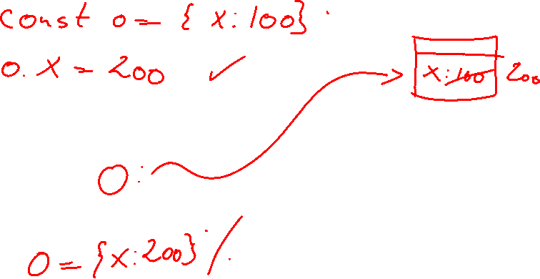
State change: Mutable Object

Slide 20
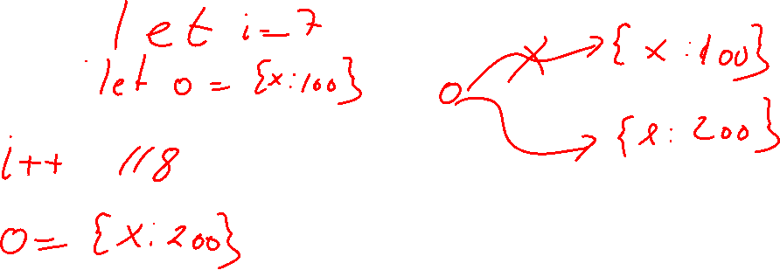
State change: changing variables

Slide 21
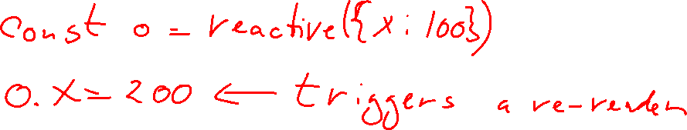
Mutable objects: reactive() is enough

Slide 22
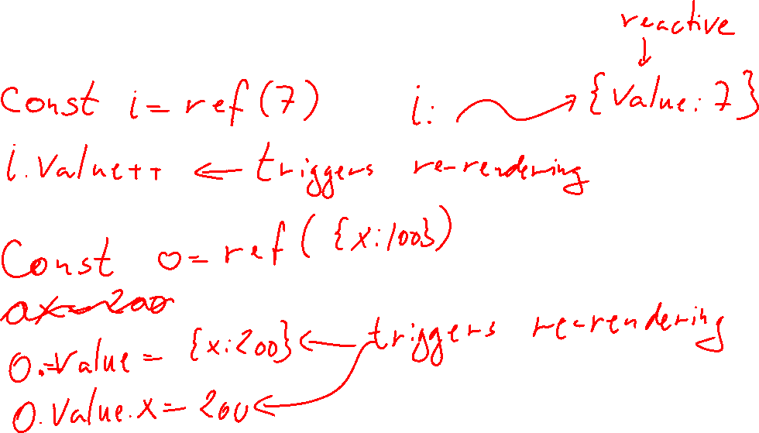
Changing variables: Use ref()

Slide 23
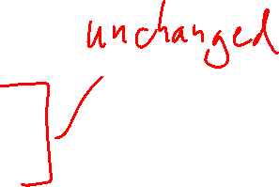
Example
const s = ref("reverse")
const reversed = computed({
get(): string { return reverse(s.value)},
set(v: string): void { s.value = reverse(v) }
})
<input v-model='s' id='normal'>
<input v-model='reversed' id='reversed'>

Slide 24
reactive()
const model = reactive(createModel(persons, employees))

Slide 25
Methods are just functions
function hire(id: number) {
const person = model.personById(id)
model.hire(person, this.salary)
salary.value = 0
error.value = undefined
}
<button v-on:click='hire(p.id)'>Hire</button>

